Slide 1

Intercultural Communication Skills and the ESOL Teacher
Marilyn J. Rymniak – BDx InterFace LLC
Spanish American Institute
AUGUST 9, 2014
10:00 a.m. – 1:00 p.m.

Slide 2
Workshop Description
Intercultural Communication Skills and the ESOL Teacher
This presentation will take a close look at why teachers of adult ESOL can benefit from intercultural communication skills training.
The following topics will be covered in this training program:
Differences that impact classroom dynamics and effectiveness in the adult ESOL classroom.
Presentation of the Bennett Developmental Model of Intercultural Sensitivity (DMIS) and the acceptance, valuing and appreciation of difference.
The introduction of 3 other standard paradigms for understanding and comparing cultural differences: The Iceberg Theory, The Hall Model, Kohl’s Model.

Slide 3
What this course is NOT!
It will NOT be a laundry list of cultural “DOs and DONTs” like the ones you might find in a tourist or travel book. These are usually too superficial or shallow, are often stereotypes and are often wrong or dated! (e.g., “Don’t show a Saudi the soles of your feet.”) They don’t really help you might for long-term relationships.
It will NOT change you overnight into a empathetic interculturalist. This will take time and requires incremental development along a continuum supplemented by actual interaction with those from other cultures.
It will NOT answer all your questions, nor will it stimulate all your questions. But it will give you some interesting academic and intellectual tools to begin finding the answers on your own or with your colleagues in the community.

Slide 4
What is “Culture”?
How do we define it?
How does “culture” relate to “values”, “behaviors”, “beliefs”?
How many “levels” of culture exist? (national?, regional?, local?, individual?)
What happens when cultures come in contact with each other?
How and how soon does one adjust to cultural differences?

Slide 5
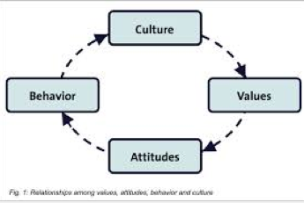
Culture can be best expressed in the complex interactions of values, attitudes ,and behavioral assumptions of a society.

Slide 6
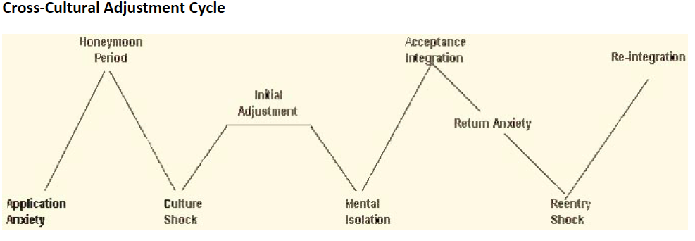

Slide 7
Generalizations, Stereotypes, Perception
We know that communication styles are patterns that people learn from the range of cultures in which they have membership. A “generalization” or “cultural norm” is the pattern of communication used by the majority of people in that cultural group. It is equally true to say that every culture has a “communication style norm” that is used by a majority of people in that culture and to say that a cultural norm is not likely to apply equally to every person in that culture. In other words, cultural norms can apply to most people in a group but do not apply to every individual in the group. When a cultural norm is applied to everyone in a group in a rigid manner, we have shifted from generalizations to stereotypes. Don’t be caught unconsciously stereotyping. Don’t automatically think one is stereotyping when they are simply making generalizations based on a cultural norm
Perception is also highly susceptible to both personal and cultural experiences.

Slide 8
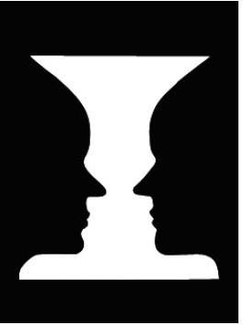
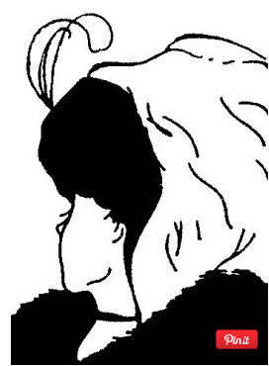
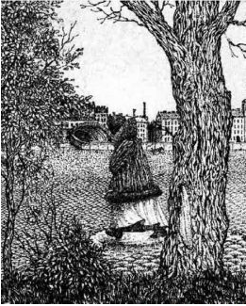
What do you see?

Slide 9
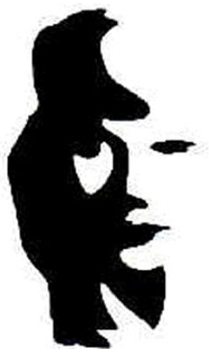

What do you see?

Slide 10
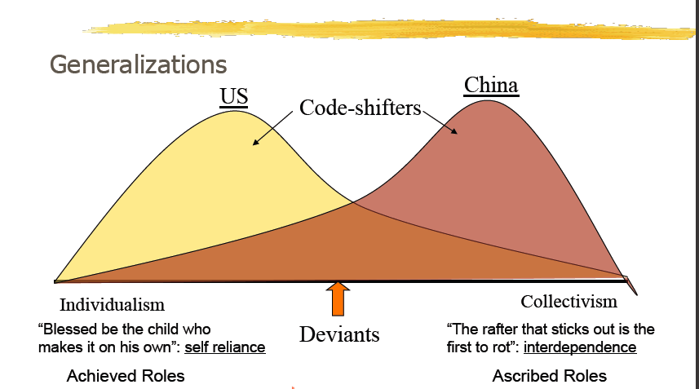
Cultural Comparisons

Slide 11
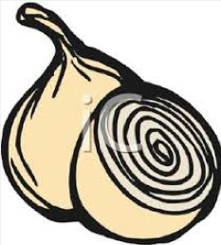
Culture as an “Onion”
Think of culture as an onion. Many, many layers make up
an onion. Culture is similar, in that our values and behaviors have many different layers.
Try drawing a mind map that describes your own layers of culture.
Inner layer: Cultural identity
Second layer: Race, gender, religion, ethnicity, social class, sexuality, age, mental and physical ability
Third layer: Communication, motivation, perceptions, attitudes, personality
Fourth layer: Occupation/career, religion, education, citizenship, generation (1st, 2nd, 3rd), language, political ideology, region (province), urban/rural, immigrant status and age at immigration, majority/minority group membership.

Slide 12
First Priority: Getting to Know Yourself as a Learner, a Person and a Cultural Being
Analyze Yourself Using
Kolb’s Learning Styles Inventory (LSI)
The Keirsey Temperament Sorter/Myers-Briggs Type Indicator (MBTI)
Howard Gardner’s Multiple Intelligences (MI) Sorter
Barbe-Milone Perceptual Modality (PM) Checklist

Slide 13
Kolb’s Four Styles of Learning
Divergers – Reflective Observation
Prefer to watch others play the game and figure it out for themselves before becoming involved – they solve problems through their own reasoning process usually by watching a demonstration by experts! FEEL and WATCH
Assimilators – Abstract Conceptualization
Prefer to learn the game by reading written instructions before attempting to play – they solve problems by inductive reasoning and are uncomfortable with random exploration! THINK and WATCH
Convergers – Active Experimentation
Prefer to participate in a well-controlled, simulated practice session – they solve problems by careful experimentation! THINK and DO
Accommodators – Concrete Experience
Prefer to jump in and just play, learning as they go – they solve problems by taking risks, preferring concrete experiences in which they just take action and see what happens! FEEL and DO

Slide 14
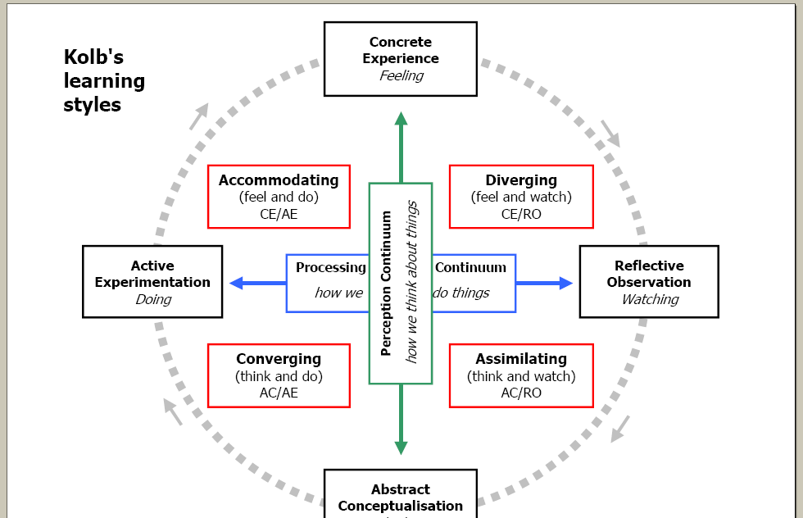
What’s Your Learning Style?

Slide 15
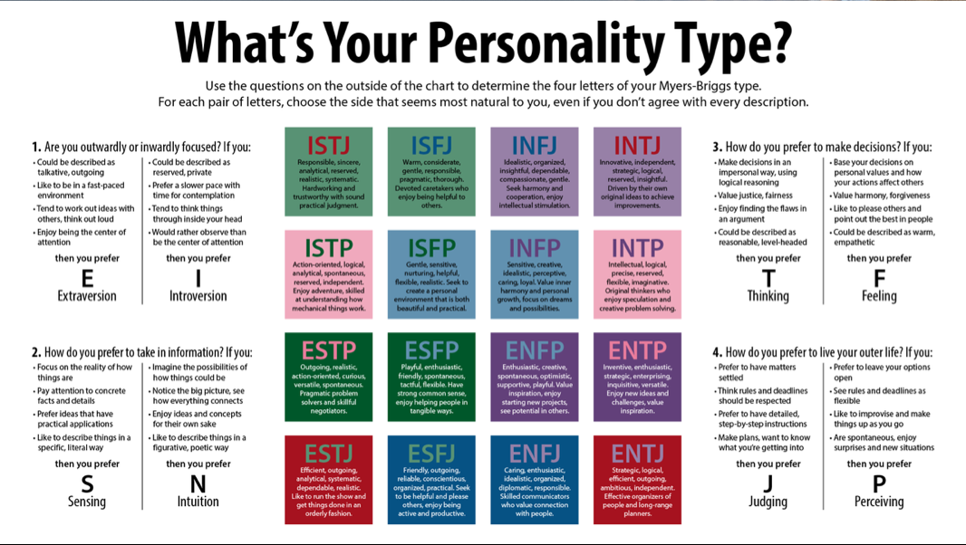

Slide 16
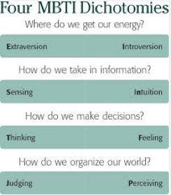

Slide 17
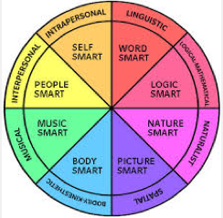
Gardner’s Multiple Intelligences

Slide 18
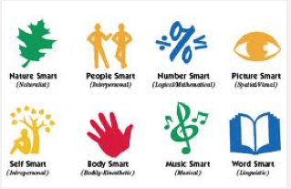
Another way of looking at Gardner… in case you are visual.

Slide 19
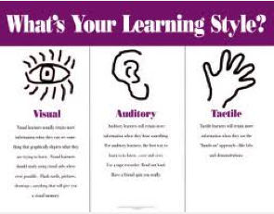

Slide 20
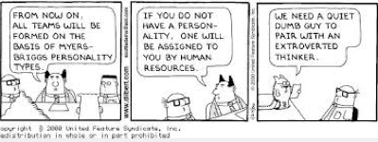
Don’t take it too far!

Slide 21
Dealing With Difference
Our initial response to difference is to avoid it. This is normal. Fight or Flight. Isolationism.
Or we try to convert the “different” group to our way of thinking. Imposing our beliefs, customs on others. Assimilation. Acculturation.
Or we simply get rid of “the other”. Separate them from us. Make their lives unbearable to live among us. Bullying, Genocide, Ethnic Cleansing, Geographic Isolation, Reservations.
Notes:
The answer to the top question lies in the answers to the following 4 questions
Just a few decades ago, this question was one faced mainly by diplomats, expatriates, foreign service officers, and the occasional foreign traveler. Now we all need to ask these questions.
I like calling this not only accepting diversity but appreciating it and actually enjoying it and valuing it. Understand, this is not normal.
Shouldn’t feel bad about this – it’s normal that we usually avoid difference – a la birds of a feather – this is being human, natural reaction. Only a few among thousands love difference.
Fight or flight – reaction to difference. Primates gathered around a fire – another group approaches – I doubt if they said “Ah, cultural diversity how wonderful!”
We flee to the suburbs to avoid cultural difference or if forced to confront it there is often a fight. This principle is at the heart of inner city gangs – the West Side Story tale – the Romeo and Juliet tale.
So many examples of conversion – the padres and the Indians in South America, the mission sof California, missionaries in China, American foreign policy. US Americanization movement.
If they were just more like us!
Killing. Many examples. Indians moved to reservations. Wounded Knee, Hitler’s Germany, Bosnia, Somalia, Sudan. Japanese internment during WWII. Keeping out immigrants.

Slide 22
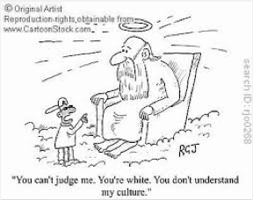
Intercultural Communication is set in Cultural Relativity

Slide 23
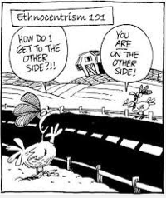

Slide 24
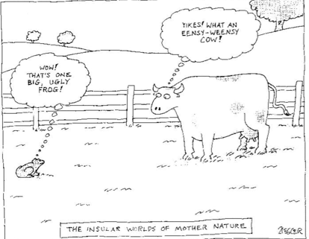

Slide 25
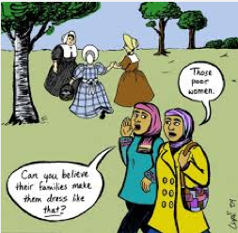

Slide 26

Valuing DIVERSITY

Slide 27
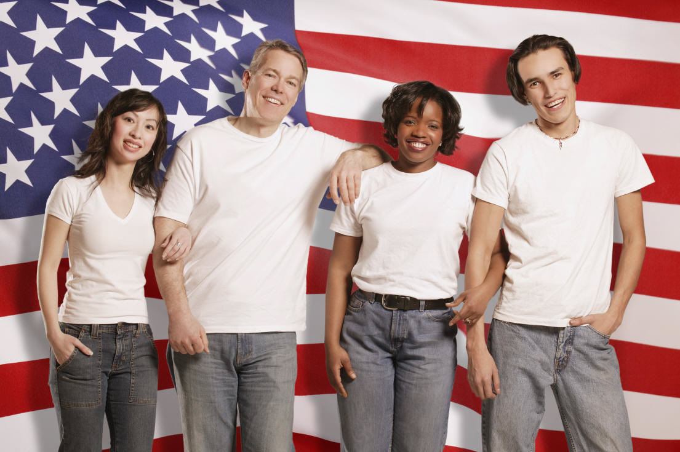
Appreciating DIFFERENCE

Slide 28
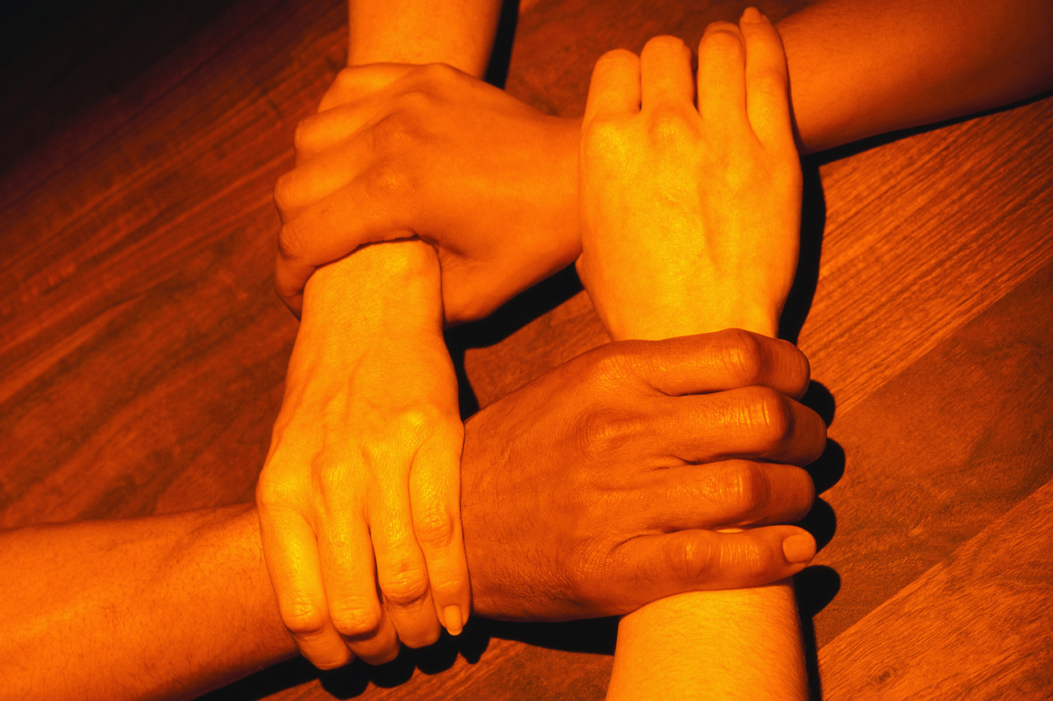
Difference
How Comfortable Are You With It?
What categories of difference do you find in the adult ESOL classroom?

Slide 29

What categories of difference are we already “used to” seeing in an adult ESOL class?
age
gender
culture
geographic origin
language dress
look
life experiences
socio-economic level
social class
ethnicity
professional/vocational
family configurations
abilities
disabilities
lifestyle choices
sexual orientation
religious beliefs
values
generational
learning styles
personality traits
… even MAC vs. PC preference!

Slide 30

Dealing with difference is NOT a natural human capability.
It is insufficient to just say “let’s be different”.
It goes against natural inclinations.

Slide 31
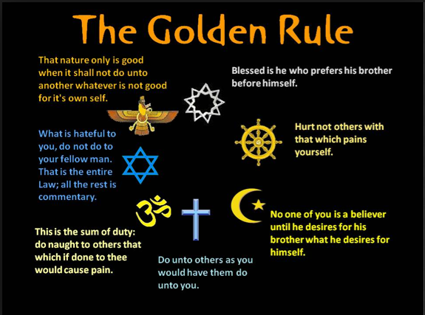

Slide 32
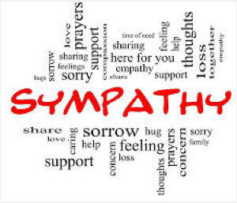
The Golden Rule

Slide 33
The Golden Rule = Sympathy
The Golden Rule: (Abridged) Treat other people the way you would like to be treated yourself
to understand another person by imagining yourself in his or her position.
The Golden Rule (Abridged) and its communication strategy, Sympathy, are based on the assumption of similarity.
We need to overcome the Golden Rule and convert it to the Platinum Rule.

Slide 34
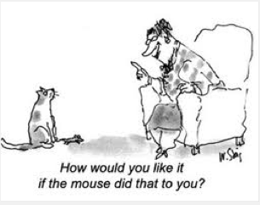

Slide 35
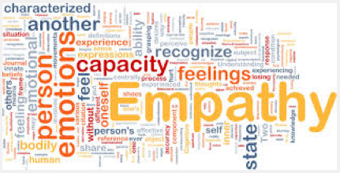
The Platinum Rule

Slide 36
Overcoming the Golden Rule = Empathy
The Platinum Rule: Treat other people the way they want to be treated (or at least be aware of what that is).
Empathy: The attempt to understand another person by imagining his or her perspective,
The Platinum Rule and its communication strategy, Empathy, are based on the assumption of difference.

Slide 37
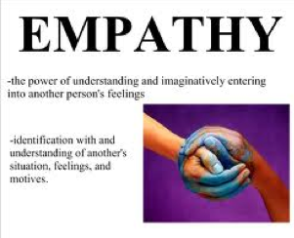

Slide 38
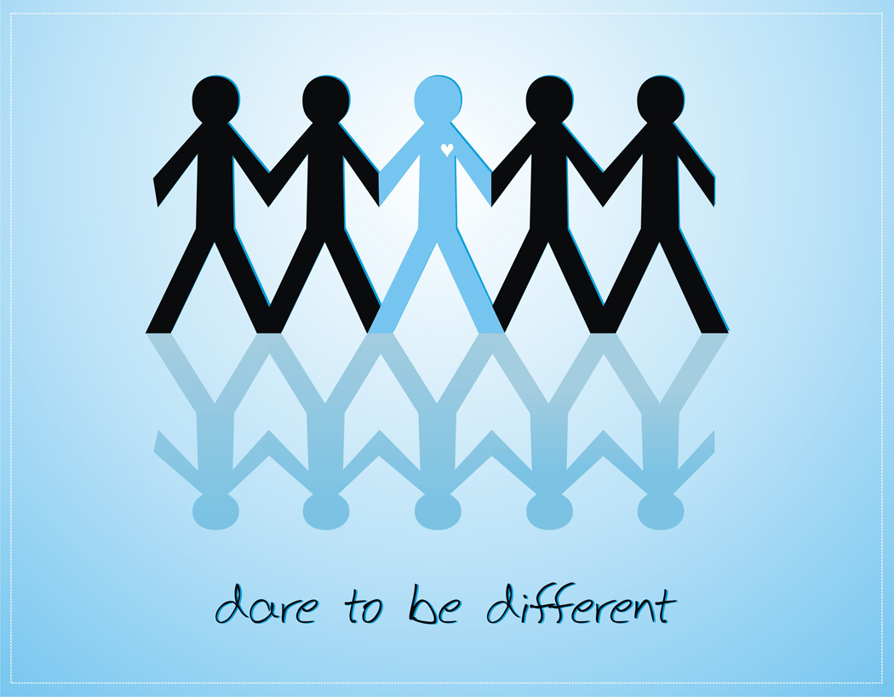
Sympathy vs. Empathy
The attempt to understand another person by imagining yourself
in his or her position
vs.
The attempt to understand another person by imagining his or her perspective.

Slide 39

The Lead Rule = The Lead Rule
Treat other people the way they deserve to be treated.

Slide 40

A Developmental Model
A developmental model addresses the question of how do people naturally react to difference.

Slide 41

A Developmental Model
Displays a continuum with “ethnocentrism” at the beginning point and “ethno-relativism” at the end point.

Slide 42

Ethnocentrism
Your view of reality, your worldview, is intrinsically more real.
Your culture is central to reality.
Your way is more natural – makes more sense.

Slide 43
Ethnorelativism
Idea of seeing things as relative.
Culture as relative to one another.
Interpreting events in the context of culture.

Slide 44
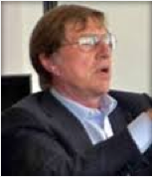
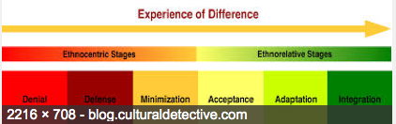
Dr. Milton J. Bennett:
“A Developmental Model of
Intercultural Sensitivity”, 1986
The Bennett scale, also called the DMIS (for Developmental Model of Intercultural Sensitivity), was developed by Dr. Milton Bennett of the Intercultural Communication Institute in Portland, Oregon.
The framework describes the different ways in which people can react to cultural differences.

Slide 45
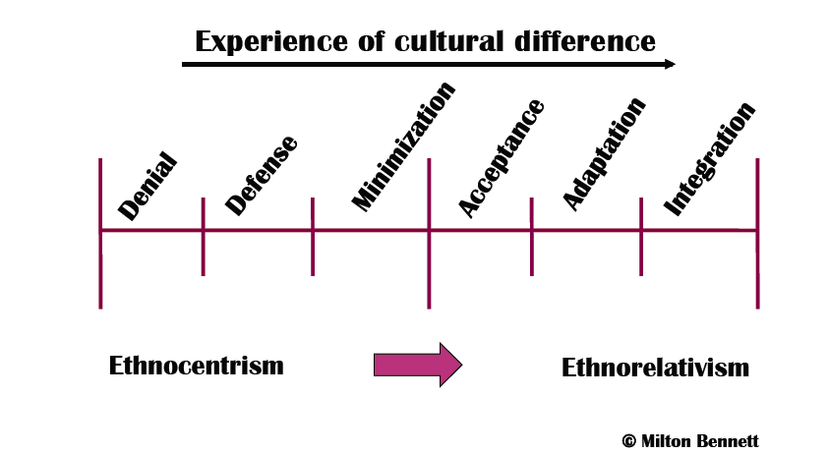
Bennett’s Developmental Model of Intercultural Sensitivity (DMIS)

Slide 46
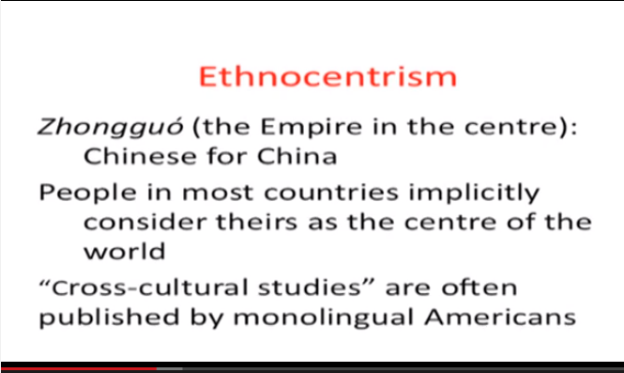
Think of How Each Country Presents the Map of the World – Most are ethnocentric!

Slide 47
Ethnocentric State # 1:
Denial of Difference
No recognition of cultural difference because of isolation or intentional separation. Attribution of deficiency in intelligence or personality to culturally deviant behavior. Tendency to dehumanize outsiders.
Issues in Denial indicate that you are comfortable with the familiar and are not anxious to complicate life with “cultural difference”. You may simply just not notice much cultural difference around you. For instance:
    In general, you may be unaware of a significant minority population in your area or you may be disinterested in multicultural or international affairs that do not immediately affect you or your family or your close circle of friends.

Slide 48
Ethnocentric State # 1:
Denial of Difference
    In general, you may be unaware of a significant minority population in your area or you may be disinterested in multicultural or international affairs that do not immediately affect you or your family or your close circle of friends.
    As a visitor in another country, you may spend most of your time concerned with the familiar categories of food, clothing, and money, instead of exploring the less-familiar idea of cultural differences.
    In business situations, you may be so intent on the tasks at hand that you do not notice much about the cultural aspects of business relationships with clients and coworkers.
    In educational settings, you may be unaware of and uninterested in the effects of cultural difference of teaching and learning.

Slide 49
Ethnocentric State # 2:
Defense Against Difference
Recognition of cultural difference coupled with negative evaluation of most variations from native culture – the greater the difference, the more negative the evaluation. Evolutionary view of cultural development with native culture at the acme. A tendency towards social/cultural proselytizing of “underdeveloped” cultures.
Issues in Defense indicate that you have a strong commitment to your own worldview and some distrust of cultural behavior or ideas that differ from your own. You are aware of other cultures around you, but you may have a relatively incomplete understanding of them and you probably have fairly strong negative stereotypes about some of them. For instance:
    You may routinely refer to people of other cultures as “them” or “you people” and you might be particularly attentive to negative qualities attributed to other groups.

Slide 50
Ethnocentric State # 2:
Defense Against Difference
    You may routinely refer to people of other cultures as “them” or “you people” and you might be particularly attentive to negative qualities attributed to other groups.
    You might belong to or sympathize with groups that stress the superiority of your own culture.
    As an educator or student, you may focus exclusively on traditional subjects and be dismissive of any non-traditional learning.
    As a manager or educator, you are likely to feel that cultural adjustment is entirely the responsibility of people who choose to move from their own cultural group into a different group.
    If you travel or live abroad, you may find yourself complaining quite a bit about the failings of your hosts.

Slide 51
Ethnocentric State # 2b:
Reversal
Tendency to see another culture as superior while denigrating one’s own.
Issues in Reversal indicate that you have a largely positive view of an adopted culture or other cultures in general and a somewhat negative opinion of your own. However, your understanding of the adopted culture may be based on positive stereotypes. For instance:
    You may be a current or former cross-cultural volunteer (e.g., Peace Corps, Vista, Americorps, etc.) who has “adopted” an idealized version of the culture to which you were assigned. In doing so, you may have also adopted some of their negative stereotypes of your own culture.

Slide 52
Ethnocentric State # 2b:
Reversal
    You may be a current or former cross-cultural volunteer (e.g., Peace Corps, Vista, Americorps, etc.) who has “adopted” an idealized version of the culture to which you were assigned. In doing so, you may have also adopted some of their negative stereotypes of your own culture.
    If you are a long-term expatriate manager in a global corporation, you may have developed a cynical view of your own culture that passes for sophistication in many international circles.
    As a member of a dominant ethnic group who is concerned with ethnic oppression, you may have disavowed your own ethnic roots in favor of being “one with” members of the oppressed group.

Slide 53
Ethnocentric State # 3:
Minimization of Difference
Recognition and acceptance of superficial differences such as eating customs, etc. While holding that all human beings are essentially the same. Emphasis on the similarity and commonality of basic values. Tendency to define the basis of commonality in ethnocentric terms (i.e., everyone is essentially like us, like me).
    Physical Universalism: Emphasis on commonality of human beings in terms of physiological or biological similarity.
    Transcendent Universalism: Emphasis on commonality of human beings as subordinate to a particular supernatural being (e.g., ”All God’s Children” idea), religion, or social philosophy (e.g., Marxian Economics)

Slide 54
Ethnocentric State # 3:
Minimization of Difference
Issues in Minimization indicate that you have gotten beyond feeling that other cultures pose a threat to your own. Your experience is that people from other cultures are pretty much like you, under the surface. You are quite aware that other cultures exist all around you, and you may know something about cultural differences in customs, celebrations, etc. You do not denigrate other cultures and you seek to avoid stereotypes by treating every person as an individual or by treating other people as you would like to be treated (sympathy). For instance:
    You may offer to be a host family for a foreign student, or volunteer for international programs, with the motivation that it will be fun and you can help the visitors understand the ways of your own culture.

Slide 55
Ethnorelative State # 1:
Acceptance of Difference
Recognition and appreciation of cultural differences in behavior and values. Acceptance of cultural differences as viable alternative solutions to the organization of human existence. Cultural relativity.
Resolved issues in Acceptance indicate that you both acknowledge and respect cultural difference. You are aware of your own culture (s), and you see that your own culture is just one of many ways of experiencing the world. When you think of people from other cultures, you imagine them as every bit as complex as yourself. Their ideas, feelings and behavior may seem unusual to you, but you realize that their experience is just as rich as your own. You may not like everything about other cultures (or everything about your own for that matter), but that fact does not make you think that any cultural group is more or less “civilized”. You are curious about other cultures and seek opportunities to learn more about them, even if you do not have opportunities to interact with members of those cultures. For instance:

Slide 56
Ethnorelative State # 1:
Acceptance of Difference
    As a manager or administrator, you probably recognize the value of global and domestic diversity in organizations. However, you may not be considering how you and the organization need to change to accommodate the diversity.
    In educational settings, you are likely to support efforts to diversify the curriculum to be more representative of a broad range of cultural perspectives.
    If you are traveling or living in other cultures, you may not act any differently than you do with members of your own culture. But you are probably aware that your behavior might be interpreted in unusual ways. You in turn are probably careful to withhold quick judgments of members of other cultures and to consider how their behavior might mean something different than it would in your own culture.

Slide 57
Ethnorelative State # 2:
Adaptation to Difference
Cognitive Frame-Shifting
The development of communication skills that enable intercultural communication. Effective use of empathy, or frame of reference shifting, to understand and be understood across cultural boundaries.
Resolved issues in the Cognitive Frame-Shifting form of Adaptation indicate that you recognize the added value of having more than one cultural perspective available to you. Further, you are able to “take the perspective” of another culture for the purpose of understanding or evaluating situations in either your own or another culture. For instance:

Slide 58
Ethnorelative State # 2:
Adaptation to Difference
Cognitive Frame-Shifting
    You may know enough about your own and at least one other culture to shift substantially into the other cultural frame of reference. You are likely to add this perspective to discussions about “how things work.”
    As a manager, teacher, administrator, you may routinely use your frame-shifting ability to act as a “bridge” between people of two different cultures for conflict resolution coordination of understanding. You become the mediator.
    In business, you are probably skeptical of training that touts the one best way of communicating, marketing, or relating to others. You know that all such behavior occurs in cultural contexts.

Slide 59
Ethnorelative State # 3:
Integration of Difference
Adaptation Behavioral Code-Shifting
The internalization of bi-cultural or multi-cultural frames of reference. Maintaining a definition of identity that is “marginal” to any particular culture.
Resolved issues in the Behavioral Code-Shifting form of Adaptation indicate that you are able to intentionally change your culturally based behavior. You have a broad repertoire of behavior that allows you to act in culturally appropriate ways outside your own culture. For instance:
    When you shift into the frame of another culture, you find that your behavior changes in a natural way to express that different view of the world. In other words, you can feel when and what different behavior is appropriate. You also may be able to intentionally change your behavior to match that of another culture, even if you are not around people from that culture.

Slide 60
Ethnorelative State # 3:
Integration of Difference
Adaptation Behavioral Code-Shifting
    When you shift into the frame of another culture, you find that your behavior changes in a natural way to express that different view of the world. In other words, you can feel when and what different behavior is appropriate. You also may be able to intentionally change your behavior to match that of another culture, even if you are not around people from that culture.
    As a business person, you are likely to be accomplished in negotiation across cultures or managing multicultural teams. You may often find yourself facilitating intercultural discussions.
    In organizations, you are likely to recognize that global and domestic diversity demands constant adaptation and that policies must reflect that need. You are probably a proponent for organizational development along these lines.
    As an educator, you may actually teach from a variety of cultural perspectives. That is, you do not simply teach about other cultural perspectives – you are able to embody them, to some degree.

Slide 61
Ethnorelative State # 3b:
Encapsulated Marginality
Issues in Encapsulated Marginality indicate that you are struggling with how to integrate your intercultural abilities with your identity. You may be asking yourself, “Now that I can shift my cultural perspective and behavior whenever I want, who am I anyway?” This condition is a transition between Adaptation and Integration (Constructive Marginality), where you are more likely to say “Who I am is a person who can move easily among cultures.” But at this point, you are probably feeling some alienation from all the cultures you know about, including your own. For instance:
    As a traditional-age or returning-adult student, you may have trouble making decisions about what to study, since everything seems equally interesting and important to one of the many careers that you are considering.

Slide 62
Ethnorelative State # 3b:
Encapsulated Marginality
    If you are returning from a long sojourn abroad and have developed an Adaptation worldview, you may experience this sense of alienation associated with re-entry into your original culture.
    In business situations, you may find yourself feeling separate from your coworkers and unable to identify with either the corporate culture or any of the national/ethnic cultures of which you may be a part.
    Although less likely, your sense of alienation may be associated with Reversal, because you are rejecting your own culture but do not have the depth in another culture to support a clear identity.
    Military Brats, Third Culture Kids,, long-term expats…….etc.

Slide 63
The Iceberg Theory of Culture
CULTURE (with a big “C”) = primarily in awareness 10%
culture (with a little “c”) = primarily out of awareness 90%

Slide 64
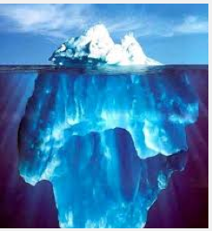
Hall’s Iceberg Theory of Culture
The Comparative Study of Values

Slide 65
The Iceberg Paradigm
Cultural differences are not always noticeable. The Iceberg Theory of Culture (perhaps a Freudian Theory) says that only 10% of any country’s culture is readily noticeable as experienced through our senses – the food, the dress, the music, the physical look, the language, the literature.
This is all part of “Culture” with a “Capital C”. It is the part of culture that is in our consciousness. It is the part of culture that we can hear, see, smell, touch and taste. It is in our primary awareness.
This part of culture rarely causes conflict – you either eat the food or you don’t, listen to the music or not. You have a choice whether to interact or not with these aspects of the culture because you are consciously aware of them.

Slide 66
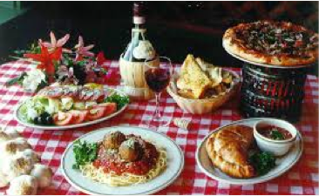

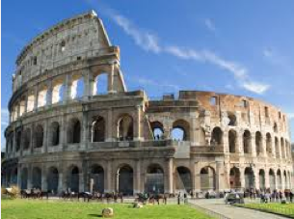
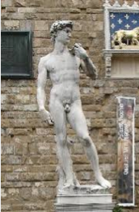
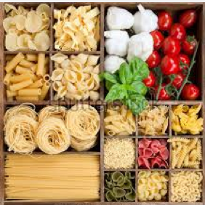
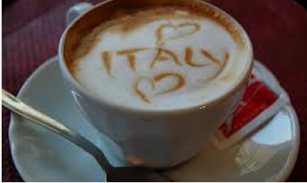
How do you define “Culture” anyway?
What does it mean if I say “I love the Italian culture!”?

Slide 67


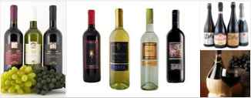
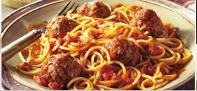
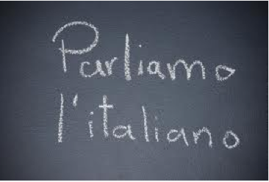
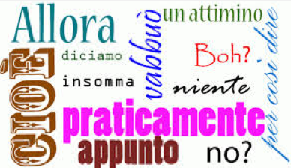
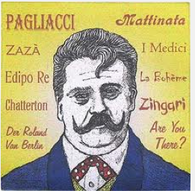
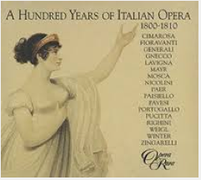
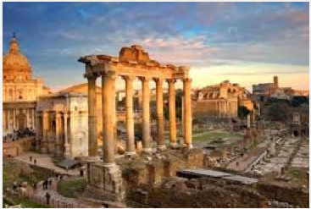
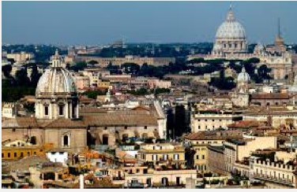
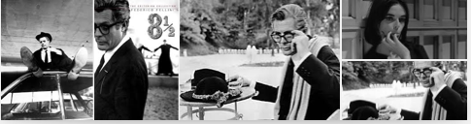
It could mean many different things, like …
I love the food!
I love the language!
I love opera!
I love Rome! I love Fellini Films!

Slide 68
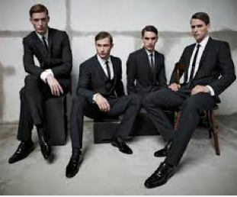
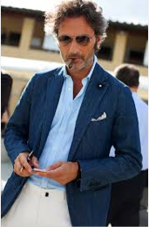

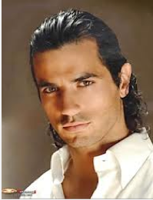


Or, it might simply mean “I love the men!”

Slide 69
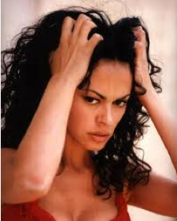





… and the women!

Slide 70


Slide 71
Above and Below the Line
Actions or superficial public behavior is cultural in origin, and yet we adopt these manners without prejudice to our own core beliefs. (e.g., use of a fork and knife when eating).
Actions are not difficult to emulate, and even different varieties of speech can be imitated to some extent. Thought and values are different.
We cannot see “thought”; we cannot hear it; it may be revealed to us with reluctance, simulation or cunning.
Cross-cultural problems arise not so much on account of our unfamiliarity with a bow, a Gallic shrug or chopsticks (all above the iceberg waterline) but in the importance and interpretation we place on certain values.

Slide 72
Below the Waterline
The 90% of the culture that is below the proverbial “waterline” is out of our conscious awareness.
But it is this part of the culture that represents the true culture of any country.
Until you have lived in another culture or among people of a different culture than the one you were brought up in, you cannot understand the difference.
You need to experience the culture on a day-to-day basis and interact with natives of that culture to become familiar with the aspects of the culture below the waterline.

Slide 73


Slide 74













“Tip-of-the-Iceberg Culture” is anything you can perceive with your five senses
  Language
  Architecture
  Food
  Population
  Music
  Clothing
  Art and Literature
  Pace of Life
  Emotional Display
  Gestures
  Leisure Activities
  Sports
  Eating Utensils
  Folk Dancing
  Games

Slide 75









“Bottom-of-the-iceberg” values determine:
  Notions of time
  How the individual fits into society
  Beliefs about human nature
  Notions about adolescence
  Importance of work – worth ethic
  Roles of adults and children in the family
  Ideals governing child raising
  Body language/Eye language
  Importance of saving face, harmony
  Communication styles
  Attitudes toward men’s and women’s roles in society
  Thinking styles –linear or systemic
  Notions of modesty
  Concepts of beauty and cleanliness
  Courtship practices
  Definition of sickness and insanity
  … and many more

Slide 76


Slide 77


Slide 78
Edward Hall’s Model
Low Context Culture
High Context Culture

Slide 79



Slide 80
Low vs. High Context Cultures
Edward T. Hall, considered by many to be the father of intercultural communication studies (he was the first to use the term), developed in his book, Beyond Culture (1976) an interesting paradigm for looking at different cultures.
Hall said that you could plot cultures along a continuum to determine how important precise words were for conveying real meaning as opposed to how important the context or situation in which you said these words is.
In Low Context Cultures (like Germanic and Scandinavian cultures), verbal instructions must be precise and able to stand on their own regardless of who says them or where or how they are said.

Slide 81

Father of American Proxemics

Slide 82
Hall’s High/Low Context Model
High context
  In a high-context culture, there are many contextual elements that help people to understand the rules. As a result, much is taken for granted. This can be very confusing for a person who does not understand the 'unwritten rules' of the culture.
Low context
  In a low-context culture, very little is taken for granted. Whilst this means that more explanation is needed, it also means there is less chance of misunderstanding particularly when visitors are present.
Contrasting the two
  French contracts tend to be short (in physical length, not time duration) as much of the information is available within the high-context French culture. American content, on the other hand, is low-context and so contracts tend to be longer in order to explain the detail.
  Highly mobile environments where people come and go need lower-context culture. With a stable population, however, a higher context culture may develop.

Slide 83
Time
Monochronic (M) Time
  M-Time, as Hall called it, means doing one thing at a time. It assumes careful planning and scheduling and is a familiar Western approach that appears in disciplines such as 'time management'.
  Monochronic people tend also to be low context.
Polychronic (P) Time
  In Polychronic cultures, human interaction is valued over time and material things, leading to a lesser concern for 'getting things done' -- they do get done, but more in their own time.
  Aboriginal and Native Americans have typical polychronic cultures, where 'talking stick' meetings can go on for as long as somebody has something to say.
  Polychronic people tend also to be high context.

Slide 84
Time
Contrasting the Two
  Western cultures vary in their focus on monochronic or polychronic time. Americans are strongly monochronic whilst the French have a much greater polychronic tendency – thus a French person may turn up to a meeting late and think nothing of it (much to the annoyance of a German or American co-worker).

Slide 85
Monchronic People
  do one thing at a time
  concentrate on the job
  compartmentalize tasks
  are low-context and need information
  are committed to the job
  adhere religiously to plans
  are concerned about not disturbing others; follow rules of privacy and consideration
  show great respect for private property
  seldom borrow or lend
  emphasize promptness
  are accustomed to short-term relationships

Slide 86
Polychronic People
  do many things at once
  are highly distractible and subject to interruptions
  rarely compartmentalize
  consider time commitments an objective to be achieved, if possible
  are high-context and already have information
  are committed to people and human relationships
  change plans often, easily and spontaneously
  are more concerned with those who are closely related (family, friends, close business associates) than with privacy)
  borrow and lend things often and easily and for long periods of time
  base promptness on the relationship
  have strong tendency to build lifetime relationships

Slide 87


Slide 88
Space
Hall was concerned about space and our relationships within it. He called the study of such space Proxemics. We have concerns about space in many situations, from personal body space to space in the office, parking space, space at home.
The need for space: Some people need more space in all areas. People who encroach into that space are seen as a threat. Personal space is an example of a mobile form of territory and people need less or greater distances between them and others. A Japanese person who needs less space thus will stand closer to an American, inadvertently making the American uncomfortable.
Some people need bigger homes, bigger cars, bigger offices and so on. This may be driven by cultural factors, for example the space in America needs to greater use of space, whilst Japanese need less space (partly as a result of limited useful space in Japan).

Slide 89
Space
High Territoriality
Some people are more territorial than others with greater concern for ownership. They seek to mark out the areas which are theirs and perhaps having boundary wars with neighbors. This happens right down to desk-level, where co-workers may do battle over a piece of paper which overlaps from one person's area to another.
At the national level, many wars have been fought over boundaries. Territoriality also extends to anything that is 'mine' and ownership concerns extend to material things. Security thus becomes a subject of great concern for people with a high need for ownership. People with high territoriality tend also to be low context.

Slide 90
Space
Low Territoriality
People with lower territoriality have less ownership of space and boundaries are less important to them. They will share territory and ownership with little thought. They also have less concern for material ownership and their sense of 'stealing' is less developed (this is more important for highly territorial people).
People with low territoriality tend also to be high context.
Contrasting
Australian Aboriginal people will say that they belong to the land rather than the other way around. Before we scotch this, we should remember that they have thrived in harsh conditions for thousands of years.

Slide 91
Space
Low Territoriality
Western society, on the other hand has shown much barbarity over ownership of land.
So what?
When working across cultures, pay attention to high and low Hall's cultural factors cultures through the actions of others. For example if people are late for meetings it may be because they are polychronic, not because they are disrespectful or lazy.
When you understand the personal, national or organizational culture, then you can seek to align with them and hence gain greater influence.

Slide 92
Low vs. High Context Cultures
In High Context Cultures (like Japanese, Arabic and Persian Cultures) the words themselves are not as important as the context in which they are said, which may include who is saying them, who else is present, what emotions are displayed, where the words are being spoken.
In a High Context Culture, the same words may mean very different things depending on the context in which they are spoken.
Americans are more Low Context than High – this is why we have so many lawyers – because we feel the words themselves must be precise.
The saying “a man is only as good as his word” is a Low Context philosophy.

Slide 93
The Hall Model
High Context
Japanese
Chinese
Arab
Greek
Mexican
Spanish
Italian
French
French Canadian
English
English Canadian
American (USA)
Scandinavian
German
Dutch
German Swiss
Low Context

Slide 94
Kohl’s Model
American Values
Other Values

Slide 95
US Values vs. Other Country’s Values
Robert Kohl’s Model attempts to explain the basic values of mainstream Americans by placing them on a continuum of what he calls “Other Country’s” values.
Foreign visitors or immigrants new to the USA are often surprised at how Americans often seem to neglect to build relationships before doing business with someone.
Americans seem to jump right in and make quick decisions rather than spending time talking small talk to get to know the other person. This is because mainstream Americans have a need to control time.
This is sometimes done at the expense of building the relationship in order to keep on schedule. This is a very simple model and it deals in bell-shaped curve generalities., so one must be careful not to fall into the trap of developing stereotypes from these.

Slide 96
US Values | Some Other Country’s Values
Personal Control over the Environment/Responsibility | Fate/Destiny
Change seen as natural and positive | Stability/Tradition/Continuity
Time and its Control | Human Interaction
Equality/Fairness | Hierarch/Rank/Status
Individualism/Independence | Group’s Welfare/Dependence
Self-Help/Initiative | Birthright Inheritance
Competition | Cooperation
Future Orientation | Past Orientation
Action/Work Orientation | “Being” Orientation
Informality | Formality
Directness/Openness/Honesty | Indirectness/Ritual/”Face”
Practicality/Efficiency | Idealism/Theory
Materialism/Acquisitiveness | Spiritualism/Detachment

Slide 97
What Americans value:
Personal Control Over the Environment
Americans no longer believe in the power of Fate, and they have come to look at people who do as being backward, primitive, or hopelessly naive. To be called “fatalistic” is one of the worst criticisms one can receive in the American context; to an American, it means one is superstitious and lazy, unwilling to take any initiative in bringing about improvements.
In the United States people consider it normal and right that Man should control Nature, rather than the other way around. More Americans find it impossible to accept that there are some things which lie beyond the power of humans to achieve. And Americans have literally gone to the moon, because they refused to accept earthly limitations.

Slide 98
What Americans value:
Change
In the American mind, change is seen as an indisputably good condition. Change is strongly linked to development, improvement, progress, and growth.
Many older, more traditional cultures consider change as a disruptive, destructive force, to be avoided if at all possible. Instead of change, such societies value stability, continuity, tradition, and a rich and ancient heritage -- none of which are valued very much in the United States.

Slide 99
What Americans value:
These first two values -- the belief that we can do anything and the belief that any change is good -- together with an American belief in the virtue of hard work and the belief that each individual has a responsibility to do the best he or she can do have helped Americans achieve some great accomplishments.
So whether these beliefs are “true” is really irrelevant; what is important is that Americans have considered them to be true and have acted as if they were, thus, in effect, causing them to happen.

Slide 100
What Americans value:
Time and its Control
Time is, for the average American, of utmost importance. To the foreign visitor, Americans seem to be more concerned with getting things accomplished on time (according to a predetermined schedule) than they are with developing deep interpersonal relations.
Schedules, for the American, are meant to be planned and then followed in the smallest detail. It may seem to most foreigners that most Americans are completely controlled by the little machines they wear on their wrists, cutting their discussions off abruptly to make it to their next appointment on time.
Americans’ language is filled with references to time, giving a clear indication of how much it is valued. Time is something to be “on,” to be “kept,” “filled,” “saved,” “used,” “spent,” “wasted,” “lost,” “gained,” “planned,” “given,” “made the most of,” even “killed”.

Slide 101
What Americans value:
The international visitor soon learns that it is considered very rude to be late – even by 10 minutes -- for an appointment in the United States. (Whenever it is absolutely impossible to be on time, you should phone ahead and tell the person you have been unavoidably detained and will be a half hour -- or whatever -- late.)
Time is so valued in America, because by considering time to be important one can clearly accomplish more than if one “wastes” time and does not keep busy. This philosophy has proven its worth. It has enabled Americans to be extremely productive, and productivity itself is highly valued in the United States.
Many American proverbs stress the value in guarding our time, using it wisely, setting and working toward specific goals, and even expending our time and energy today so that the fruits of our labor may be enjoyed at a later time. (This latter concept is called “delayed gratification.”)

Slide 102
What Americans value:
Equality/Egalitarianism
Equality is, for Americans, one of their most cherished values. This concept is so important for Americans that they have even given it a religious basis. They say all people have been “created equal.”
Most Americans believe that God views all humans alike without regard to intelligence, physical condition or economic status. In secular terms this belief is translated into the assertion that all people have an equal opportunity to succeed in life. Americans differ in opinion about how to make this ideal into a reality. Yet virtually all agree that equality is an important civic and social goal.
The equality concept often makes Americans seem strange to foreign visitors. Seven-eighths of the world feels quite differently. To them, rank and status and authority are seen as much more desirable considerations -- even if they personally happen to find themselves near the bottom of the social order.
Class and authority seem to give people in those other societies a sense of security and certainty. People outside the United States consider it reassuring to know, from birth, who they are and where they fit into the complex system called “society.”

Slide 103
What Americans value:
Equality/Egalitarianism
Many highly-placed foreign visitors to the United States are insulted by the way they are treated by service personnel (such as waiters in restaurants, clerks in stores, taxi drivers, etc.)
Americans have an aversion to treating people of high position in a deferential manner, and conversely, often treat lower class people as if they were very important.
Newcomers to the United States should realize that no insult or personal indignity is intended by this lack of deference to rank or position in society. A foreigner should be prepared to be considered “just like anybody else” while in the country.

Slide 104
What Americans value:
Individualism and Privacy
The individualism which has been developed in the western world since the Renaissance, beginning in the late 15th century, has taken its most exaggerated form in 20th/21st century United States. Here, each individual is seen as completely and marvelously unique, that is, totally different from all other individuals and, therefore, particularly precious and wonderful.
Americans think they are more individualistic in their thoughts and actions than, in fact, they are. They resist being thought of as representatives of a homogeneous group, whatever the group.
They may, and do, join groups -- in fact many groups -- but somehow believe they’re just a little unique, just a little special, from other members of the same group. And they tend to leave groups as easily as they enter them.

Slide 105
What Americans value:
Privacy, the ultimate result of individualism is perhaps even more difficult for the foreigner to comprehend. The word “privacy” does not even exist in many languages. If it does, it is likely to have a strongly negative connotation, suggesting loneliness or isolation from the group.
In the United States, privacy is not only seen as a very positive condition, but it is also viewed as a requirement which all humans would find equally necessary, desirable and satisfying. It is not uncommon for Americans to say -- and believe – such statements as “If I don’t have at least half an hour a day to myself, I will go stark raving mad!”
Individualism, as it exists in the United States, does mean that you will find a much greater variety of opinions (along with the absolute freedom to express them anywhere and anytime) here.
Yet, in spite of this wide range of personal opinion, almost all Americans will ultimately vote for one of the two major political parties. This is what was meant by the statement made earlier that Americans take pride in crediting themselves with claiming more individualism than, in fact, they really have.

Slide 106
What Americans value:
Self-Help Concept
In the United States, a person can take credit only for what he or she has accomplished by himself or herself. Americans get no credit whatsoever for having been born into a rich family. (In the United States, that would be considered “an accident of birth.”)
Americans pride themselves in having been born poor and, through their own sacrifice and hard work, having climbed the difficult ladder of success to whatever level they have achieved -- all by themselves.
The American social system has, of course, made it possible for Americans to move, relatively easily, up the social ladder. Take a look in an English-language dictionary at the composite words that have the word “self” as a prefix. In the average desk dictionary, there will be more than 100 such words, words like self-confidence, self-conscious, self-contented, self-control, self-criticism, self-deception, self-defeating, self-denial, self-discipline, self-esteem, self-expression, self-importance, self-improvement, self-interest, self-reliance, self-respect, self-restraint, self-sacrifice -- the list goes on and on. The equivalent of these words cannot be found in most other languages. This list is perhaps the best indication of how seriously Americans take doing things for one’s self. The “self-made man or woman” is still very much the ideal in 21st Century America.

Slide 107
What Americans value:
Competition and Free Enterprise
Americans believe that competition brings out the best in any individual. They assert that it challenges or forces each person to produce the very best that is humanly possible. Consequently, the foreign visitor will see competition being fostered in the American home and in the American classroom, even on the youngest age levels. Very young children , for instance, are encouraged to answer questions for which their classmates do not know the answers.
Foreigners may find the competitive value disagreeable, especially if you come from a society which promotes cooperation rather than competition. But many U.S. Peace Corps volunteers teaching in Third World countries found the lack of competitiveness in a classroom situation equally distressing. They soon learned that what they had thought to be one of the universal human characteristics represented only a peculiarly American (or Western) value.

Slide 108
What Americans value:
Competition and Free Enterprise
Americans, valuing competition, have devised an economic system to go with it -- free enterprise. Americans feel very strongly that a highly competitive economy will bring out the best in its people and ultimately, that the society which fosters competition will progress most rapidly. If you look for it, you will see evidence in all areas -- even in fields as diverse as medicine, the arts, education, and sports -- that free enterprise is the approach most often preferred in America.

Slide 109
What Americans value:
Future Orientation
Valuing the future and the improvements Americans are sure the future will bring means that they devalue the past and are, to a large extent, unconscious of the present. Even a happy present goes largely unnoticed because, happy as it may be, Americans have traditionally been hopeful that the future would bring even greater happiness. Almost all energy is directed toward realizing that better future. At best, the present condition is seen as preparatory to a later and greater event, which will eventually culminate in something even more worthwhile.
Since Americans have been taught (in value #1) to believe that Man, and not Fate, can and should be the one who controls the environment, this has made them very good at planning and executing short-term projects. This ability, in turn, has caused Americans to be invited to all corners of the earth to plan and achieve the miracles which their goal setting can produce.

Slide 110
What Americans value:
If you come from a culture such as those in the traditional Moslem world, where talking about or actively planning the future is felt to be futile, even sinful, activity, you will have not only philosophical problems with this very American characteristic but religious objections as well. Yet it is something you will have to learn to live with, for all around you Americans will be looking toward the future and what it will bring.

Slide 111
What Americans value:
Action/Work Orientation
“Don’t just stand there,” goes a typical bit of American advice, “do something!” This expression is normally used in a crisis situation, yet, in a sense, it describes most Americans’ entire waking life, where action -- any action -- is seen to be superior to inaction.
Americans routinely plan and schedule an extremely active day. Any relaxation must be limited in time, pre-planned, and aimed at “recreating” their ability to work harder and more productively once the recreation is over.
Americans believe leisure activities should assume a relatively small portion of one’s total life. People think that it is “sinful” to “waste one’s time,” “to sit around doing nothing,” or just to “daydream.”

Slide 112
What Americans value:
Such a “no nonsense” attitude toward life has created many people who have come to be known as “workaholics,” or people who are addicted to their work, who think constantly about their jobs and who are frustrated if they are kept away from them, even during their evening hours and weekends.
The workaholic syndrome, in turn, causes Americans to identify themselves wholly with their professions. The first question one American will ask another American when meeting for the first time is related to his or her work: “What do you do?,” “Where do you work?,” or “Who (what company) are you with?”
And when such a person finally goes on vacation, even the vacation will be carefully planned, very busy and active. America may be one of the few countries in the world where it seems reasonable to speak about the “dignity of human labor,” meaning by that, hard, physical labor. In
America, even corporation presidents will engage in physical labor from time to time and gain, rather than lose, respect from others for such action.

Slide 113
What Americans value:
Informality
If you come from a more formal society, you will likely find Americans to be extremely informal, and you will probably feel, even disrespectful of those in authority. Americans are one of the most informal and casual people in the world, even when compared to their near relative -- the Western European.
As one example of this informality, American bosses often urge their employees to call them by their first names and even feel uncomfortable if they are called by the title “Mr.” or “Mrs.”
Dress is another area where American informality will be most noticeable, perhaps even shocking. One can go to a symphony performance, for example, in any large American city nowadays and find some people in the audience dressed in blue jeans and tieless, short-sleeved shirts.

Slide 114
What Americans value:
Informality is also apparent in Americans’ greetings. The more formal “How are you?” has largely been replaced with an informal “Hi.” This is as likely to be used to one’s superior as to one’s best friend.
If you are a highly placed official in your own country, you will probably, at first, find such informality to be very unsettling. Americans, on the other hand, would consider such informality as a compliment! Certainly it is not intended as an insult and should not be taken as such.

Slide 115
What Americans value:
Directness, Openness and Honesty
Many other countries have developed subtle, sometimes highly ritualistic, ways of informing other people of unpleasant information. Americans, however, have always preferred the direct approach. They are likely to be completely honest in delivering their negative evaluations. If you come from a society which uses the indirect manner of conveying bad news or uncomplimentary evaluations, you will be shocked at Americans’ bluntness.
If you come from a country where saving face is important, be assured that Americans are not trying to make you lose face with their directness. It is important to realize that an American would not, in such cases, lose face. The burden of adjustment, in all cases while you are in this country, will be on you.
There is no way to soften the blow of such directness and openness if you are not used to it except to tell you that the rules have changed while you are here. Indeed, Americans are trying to urge their fellow countrymen to become even more open and direct. The large number of “assertiveness” training courses which appeared in the United States in the late 1970s reflects such a commitment.

Slide 116
What Americans value:
Directness, Openness and Honesty
Americans consider anything other than the most direct and open approach to be dishonest and insincere and will quickly lose confidence in and distrust for anyone who hints at what is intended rather than saying it outright. Anyone who, in the United States, chooses to use an intermediary to deliver the message will also be considered manipulative and untrustworthy.

Slide 117
What Americans value:
Practicality and Efficiency
Americans have a reputation of being an extremely realistic, practical and efficient people. The practical consideration is likely to be given highest priority in making any important decision in the United States. Americans pride themselves in not being very philosophically or theoretically oriented. If Americans would even admit to having a philosophy, it would probably be that of pragmatism.
Will it make any money? Will it “pay its own way?” What can I gain from this practical pursuit, not such questions as: Is it aesthetically pleasing? Will it be enjoyable?, or Will it advance the cause of knowledge?
This practical, pragmatic orientation has caused Americans to contribute more inventions to the world than any other country in human history. The love of “practicality” has also caused Americans to view some professions more favorably than others. Management and economics, for example, are much more popular in the United States than philosophy or anthropology, law and medicine more valued than the arts.

Slide 118
What Americans value:
Practicality and Efficiency
Another way in which this favoring of the practical makes itself felt in the United States, is a belittling of “emotional” and “subjective” evaluations in favor of “rational” and “objective” assessments. Americans try to avoid being too sentimental in making their decisions. They judge every situation “on its merits.”
The popular American “trial-and error” approach to problem-solving also reflects the practical. This approach suggests listing several possible solutions to any given problem, then trying them out, one-by-one, to see which is most effective.

Slide 119
What Americans value:
Materialism/Acquisitions
Foreigners generally consider Americans much more materialistic than Americans are likely to consider themselves. Americans would like to think that their material objects are just the natural benefits which always result from hard work and serious intent – a reward, they think, which all people could enjoy were they as industrious and hardworking as Americans.
But by any standard, Americans are materialistic. This means that they value and collect more material objects than most people would ever dream of owning. It also means they give higher priority to obtaining, maintaining and protecting their material objects than they do in developing and enjoying interpersonal relationships.

Slide 120
Managing a Conversation With Someone from Another Culture
Managing a successful interaction can be a challenge even when we are speaking to someone from our own culture. The proper use of language style and the chosen verbal and non-verbal interface can make or break an attempt to communicate interculturally.
Struggling the interaction. One of the most boggling aspects of being in another culture is learning the subtle verbal and nonverbal cues which serve as the “steering and controlling” mechanisms in a conversation.
    Starting a Conversation: Whether one is interested in developing a romantic relationship or a friendship deciding how to start the conversation is a primary step in the process.
        Getting Attention: What is the appropriate way to get someone’s attention in your culture? Of the same sex? A stranger? A friend? Of the opposite sex? A stranger? A friend? Does status make a difference? Higher? Lower?
        Greetings: What phrases are simply form or ritual? How long should it take to greet someone? Should you touch?
        Topics of Conversation: What is okay to talk about with a stranger? A casual acquaintance? A close friend?
    Turn Taking: Sometimes it is difficult to know just when it is your turn to speak.
        Interrupting: Is it ever okay? When is it not okay?
        Silences: Do they help or hinder and interaction? How long can you be silent or pause in a conversation before people will become uneasy?

Slide 121
Managing a Conversation With Someone from Another Culture
        Silences: Do they help or hinder and interaction? How long can you be silent or pause in a conversation before people will become uneasy? If you are asked a question, what does it mean if you hesitate or are silent before you answer?
        Changing the Topic of Conversation: When is it polite to change the topic of conversation? How do you know if someone is no longer interested in what you are talking about? How would you let someone else know that you are no longer interested?
        Ending a Conversation: How you end a conversation can set the stage for further interactions with someone. How do we know the conversation is at an end?
          Sequencing and Signals: What are some non-verbal cues that tell you a conversation is at an end in your culture? Eyes? Tone of voice? Body posture? Use of space? Gestures? What are the verbal cues? Phrases? Interjections?
          Reinforcing Relationships: What phrases are exchanged that are automatic or “just form”? Is touching ever appropriate? What kind? Is it appropriate to extend an invitation to get together again? Are all such invitations sincere? If not, how do you know the difference?

Slide 122
Managing a Conversation With Someone from Another Culture
        Communication Breakdowns: Even among the most experienced communicators, misunderstanding can occur. If we feel someone has been rude or thoughtless, or if we simply aren’t sure what they are trying to tell us, what can we do about it?
              When is it appropriate to confront someone who you feel is rude or thoughtless? If you are angry with someone should/do you tell them?
              If someone is angry with you, should you talk about what is bothering them? Simply apologize to restore harmony? Walk away? If someone is confusing you or you can’t understand them, should you tell them? Is there another way to indicate confusion? Should it be covered up?
    Maintaining a Conversation: Just what do we do and say after we have said “Hello?” Fear of being able to communicate successfully can discourage many people from ever starting a conversation.
        Listening Cues: Just how important is it to listen carefully? How do we feel when we think someone is not paying attention to us? How do we feel when we are expected to listen but aren’t interested?
            What nonverbal signals tell someone that we are listening to them? Not listening? What verbal signals say we are listening? Not listening? What verbal and non-verbal signals do we give to encourage someone to keep talking? To stop?

Slide 123
Managing a Conversation With Someone from Another Culture
        Volunteering:
          Information: What kinds of things is it polite to tell people if they have not asked you a question? If they have asked you something, should you only answer with the specific information requested? Should you elaborate? is background needed?
          Opinions: Should you volunteer your opinion on a particular issue being discussed? To whom? Is status important in deciding this? How would you offer your opinion – in a story, directly? If asked directly for your opinion would you tell the person if you disagree with him/her?
          Questioning: Is it polite to ask a direct question about someone’s feelings? Ideas? Family? If you asked, would you expect a direct answer? How do you go about getting additional information if you feel you need it but it is not offered?
          Joking, Kidding, Teasing: What sorts of things are okay to joke about? Who can you joke with? Who can you tease? What form might the teasing take?
          Compliments: When would you give a compliment? To whom? Why? Where? How should a person respond when a compliment is given? What are appropriate things to compliment a person about? Males? Females? Children?
          Apologies: How often should a person apologize if they have offended someone? When should a person a person apologize? To whom should a person apologize? When do you know if an apology is necessary?

Slide 124

Questions and Issues For Further Discussion

Slide 125

Thank You!
It has been a pleasure working with all of you.

Slide 126
Do Not Hesitate to Contact Me
Marilyn J. Rymniak
Managing Executive Director
BDx InterFace LLC
Dean Emeritus, LAC Academy
100 United Nations Plaza, Suite12F
New York, NY 10017
212.308.0251
bdxinterface@nyc.rr.com
www.linkedin.com/in/marilynjrymniak/

